Slide 1
PostgreSQL – Ch 6 - 10
and such…
CSSE533 – Weeks 6 and 7
Topics for Tues, Week 6 – Slide 2
Topics for Thurs, Week 6 – Slide 22
Topics for Week 7 – Slide 35
Notes:
Image from http://www.reddit.com/r/4chan/comments/2a8993/anon_tries_to_understand_tumblr_triggers/

Slide 2
Topics for Tues, 4-14-15
From yesterday’s email:
Discuss what topics out of the rest of the PostgreSQL book are especially relevant to your project and/or you have a personal interest in.
I’ll be ready to discuss a lot of them, maybe not all in infinite depth. But I’ll be happy to dig in on those you think are most valuable.
And - I’ll be eager to hear how your individual endeavors are going, of course!
And, I thought of one more thing:
Any topics you’d like to review from DB “basics”?
Your book authors assume you’re already a practitioner, who just wants to learn about PostgreSQL.
E.g., “Here’s what’s different about doing Joins.”

Slide 3
Typical topics taught in a first DB class
Database Theory
Modeling (ER, Relational, Normalization, Dependencies)
Relational Algebra
SQL, Transact-SQL
Constraints
Store Procedures
Authorization
Transactions
XML
Object Orientation
Database Practice
Managing DB Files, Security
Admin Tasks
Monitoring Performance
Implementing DB Design
Managing Databases, Creating Data Types and Tables
Data Integrity
Indexes
Views
Stored Procedures
Triggers
Retrieving, Grouping
Joining Tables
Modifying Data
Notes:
From the one I taught here at Rose, 2006-7

Slide 4
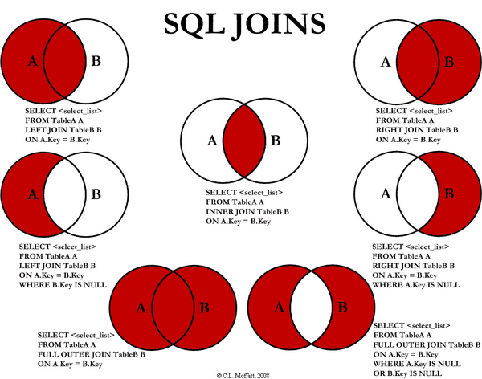
Example – Joins – a review
Let’s look at http://www.w3schools.com/sql/sql_join.asp.
Notes:
Image from http://stackoverflow.com/questions/38549/difference-between-inner-and-outer-joins

Slide 5
Example – normal forms – a review
First normal form – “All occurrences of a record type must contain the same number of fields.
Does this one blow away your intended design?
Second and third normal forms – deal with nonkey vs key fields:
A nonkey field must provide a fact about the key, the whole key, and nothing but the key.
Notes:
Ref http://www.iai.uni-bonn.de/III/lehre/vorlesungen/TDWA/WS07/1.pdf

Slide 6
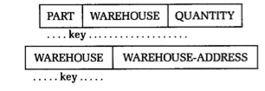
Normal forms, cntd
Second – In this record, part and warehouse are combined to makeup the key:
And the warehouse-address would be repeated for every occurrence of warehouse. Instead, needs to be 2 records:

Slide 7
Normal forms, cntd
Third – employee is the key in:
But if each department is located in only one place, then location is a fact about department, in addition to being a fact about employee. It will be repeated unnecessarily. Instead should be two records:
How does normalizing impact your project design?

Slide 8
What’s in Ch 6 – 10?
Ch 6 – Tables, constraints, and indexes
Ch 7 – SQL: The PostgreSQL way
Views – see following slides →
Handy constructions
FILTER clause for aggregates
Window functions
Common table expressions
Lateral joins

Slide 9
What’s in Ch 6 – 10? - cntd
Ch 8 – Writing functions (i.e., stored procedures)
Anatomy of PostgreSQL functions
Writing functions with SQL
Writing PL/pgSQL functions
Writing PL/Python functions
Writing PL/V8, PL/CoffeeScript, and PL/LiveScript functions

Slide 10
What’s in Ch 6 – 10? - cntd
Ch 9 – Query performance tuning
EXPLAIN
Caching
Writing better queries
Ch 10 – Replication and external data
See following slides →
Replication overview
Setting up replication
Foreign data wrappers

Slide 11
Ch 7 – SQL: The PostgreSQL way
Views – p 121:
Short intro on views
Single table views
Short intro on triggers
Using triggers to update views
Materialized views

Slide 12
Ch 7 – Views, cntd
Original idea of a “view” was more like:
A way to provide proper access to the data in the database, for some class of user. E.g., for security.
It’s now expanded to be:
The result of a query, stored in the DB.
The query command is stored in the DB dictionary.
The view is not part of the physical schema (in RDB’s).
Changes in underlying data are reflected in the view.
The view can be the result of a join or of aggregation (sum, average, etc.).
The DB doesn’t actually store a copy of the view’s data.
Views can be updatable – causing all kinds of fun.

Slide 13
Ch 7 – Views in PostgreSQL
Single table views:
Recursive views (really iterative):
Often used with hierarchical data.
CREATE VIEW comedies AS
SELECT *
FROM films
WHERE kind = 'Comedy';
CREATE RECURSIVE VIEW nums_1_100 (n) AS
VALUES (1)
UNION ALL
SELECT n+1 FROM nums_1_100 WHERE n < 100;
Notes:
From http://www.postgresql.org/docs/9.3/static/sql-createview.html

Slide 14
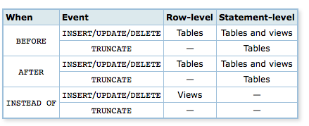
Ch 7 – Short intro on triggers
Types of triggers:
A trigger is associated with a specified table or view, and is executed when certain events occur.

Slide 15
Ch 7 – triggers, cntd
Can be used to update views:
When a view draws from more than one table, updating the underlying data with a simple command isn’t possible.
Inherent ambiguity about changing underlying data!
Can still modify the data using triggers.
Can define one or more INSTEAD OF triggers.
Need to handle INSERT, UPDATE, DELETE.
Notes:
P 123.

Slide 16
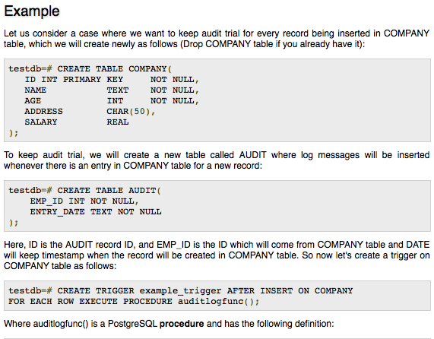
Ch 7 – triggers, cntd
Notes:
From http://www.tutorialspoint.com/postgresql/postgresql_triggers.htm

Slide 17
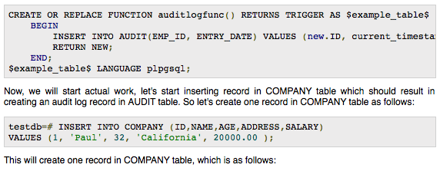
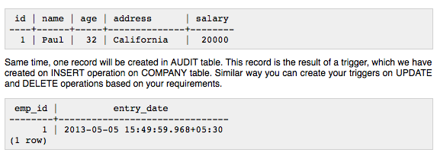
Ch 7 – triggers, cntd
Notes:
From http://www.tutorialspoint.com/postgresql/postgresql_triggers.htm

Slide 18
Ch 7 – Materialized views
As of PostgreSQL 9.3, these cache data fetched.
Use when the underlying query takes a long time, and
When having timely data is not critical.
Like with OLAP applications (Online Analytical Processing)
Watching stuff materialize – always a riot!
Notes:
Image from http://www.grahamreid.tv/materialize/

Slide 19
Ch 10 – Replication and external data
Replication overview
Main reasons:
Availability
Scalability
Replication jargon:
Master
Slave
Subscriber or agent
Write-ahead log (WAL)
(transaction log)
Synchronous
At least one slave is updated before transaction is complete
Asynchronous
Streaming
A PostgreSQL protocol
Cascading replication
Slaves passing along logs
Remastering
Promoting a slave to a master
Poor choice for promotion – Aethelred the Unready, King of the English when he was about ten years old.

Slide 20
Ch 10 – Replication and external data
Setting up replication
Configure the master
Takes five steps – pp 184-5.
Configure the slaves
Takes seven steps
Initiate the replication process

Slide 21
Ch 10 – Replication and external data
Foreign data wrappers (FDW’s)
You can query many kinds of data outside of PostgreSQL:
Flat files, including “jagged arrays”
Other PostgreSQL servers
Nonconventional data sources – like other kinds of databases
Uses a Foreign Table to guide access.

Slide 22
Topics for Thursday, by popular demand
Jon –
Ch 8 – writing functions
PL/pgSQL
Mike added PL/Python, more advanced functions
Ch 9 – query performance tuning
And benchmarks
Ch 7 – common table expressions

Slide 23
Ch 7 – common table expressions
“Sub-queries”
Define temporary tables just for this query.
Uses WITH to introduce the CTE.
Allows you to define a query that can be used by a larger query – p 138.
Basic CTE –
Makes SQL more readable. Or,
Encourages the planner to materialize intermediate results for better performance.
Writable CTE –
Adds UPDATE, INSERT and DELETE commands.
Recursive CTE –
Rows returned vary during query execution.

Slide 24
Basic CTE example
WITH regional_sales AS (
SELECT region, SUM(amount) AS total_sales
FROM orders
GROUP BY region
), top_regions AS (
SELECT region
FROM regional_sales
WHERE total_sales > (SELECT SUM(total_sales)/10 FROM regional_sales)
)
SELECT region,
product,
SUM(quantity) AS product_units,
SUM(amount) AS product_sales
FROM orders
WHERE region IN (SELECT region FROM top_regions)
GROUP BY region, product;
Displays per-product sales totals in only the top sales regions.
Notes:
From http://www.postgresql.org/docs/8.4/static/queries-with.html.

Slide 25
Ch 8 – writing functions - PL/pgSQL
First part of Ch 8 talks about writing functions in SQL.
Can “outgrow” what SQL can do – p 154
See Ex 8-4, top, p 151 for SQL version.
Compare to Ex 8-10, p 154. Similar!
Can’t write trigger functions in SQL.
This decouples those from the triggers themselves.
Also can group a block of computation or series of queries on the DB server, making this code like a procedural language for SQL.
Less traffic to/from an application.
Simplifies application coding.
Notes:
See http://www.postgresql.org/docs/8.2/static/plpgsql.html.

Slide 26
PL/pgSQL – Example 1
CREATE FUNCTION cs_refresh_mviews() RETURNS integer AS $$
DECLARE
mviews RECORD;
BEGIN
PERFORM cs_log('Refreshing materialized views...');
FOR mviews IN SELECT * FROM cs_materialized_views ORDER BY sort_key LOOP
-- Now "mviews" has one record from cs_materialized_views
PERFORM cs_log('Refreshing materialized view ' || quote_ident(mviews.mv_name) || ' ...');
EXECUTE 'TRUNCATE TABLE ' || quote_ident(mviews.mv_name);
EXECUTE 'INSERT INTO ' || quote_ident(mviews.mv_name) || ' ' || mviews.mv_query;
END LOOP;
PERFORM cs_log('Done refreshing materialized views.');
RETURN 1;
END;
$$ LANGUAGE plpgsql;
The target is successively assigned each row resulting from the query and the loop body is executed for each row.
Notes:
From http://www.postgresql.org/docs/8.2/static/plpgsql-control-structures.html#PLPGSQL-STATEMENTS-RETURNING

Slide 27
PL/pgSQL – Example 2
CREATE TABLE db (a INT PRIMARY KEY, b TEXT);
CREATE FUNCTION merge_db(key INT, data TEXT) RETURNS VOID AS
$$
BEGIN
LOOP
UPDATE db SET b = data WHERE a = key;
IF found THEN
RETURN;
END IF;
BEGIN
INSERT INTO db(a,b) VALUES (key, data);
RETURN;
EXCEPTION WHEN unique_violation THEN
-- do nothing
END;
END LOOP;
END;
$$
LANGUAGE plpgsql;
SELECT merge_db(1, 'david');
SELECT merge_db(1, 'dennis');
This example uses exception handling to perform either UPDATE or INSERT, as appropriate.
Notes:
From http://www.postgresql.org/docs/8.2/static/plpgsql-control-structures.html#PLPGSQL-STATEMENTS-RETURNING

Slide 28
PL/pgSQL – Example 3
A frequent question in IRC (?) is how to delete rows that are duplicates over a set of columns, keeping only the one with the lowest ID.
This query does that for all rows of tablename having the same column1, column2, and column3.
DELETE FROM tablename
WHERE id IN (SELECT id
FROM (SELECT id,
row_number() over (partition BY column1, column2, column3 ORDER BY id) AS rnum
FROM tablename) t
WHERE t.rnum > 1);
Notes:
From https://wiki.postgresql.org/wiki/Category:Snippets

Slide 29
Ch 8 – writing functions - PL/Python
Lets you use Python libraries.
Can compose functions in Python.
Need to install Python on the server.
The PostgreSQL Python extension is:
CREATE EXTENSION plpython3u;

Slide 30
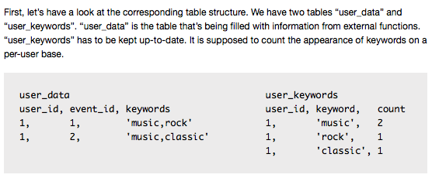
PL/Python Example – INSERT trigger
→
Notes:
From http://anitagraser.com/2010/12/10/plpython-pythonic-trigger-functions-for-postgres/

Slide 31
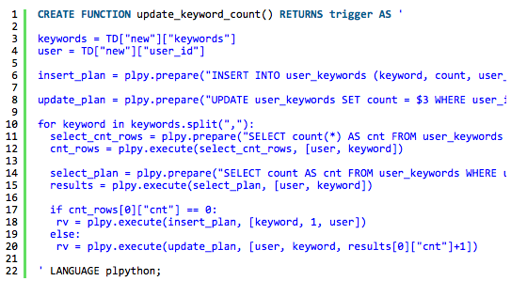
PL/Python Example – INSERT trigger, cntd
→
Notes:
From http://anitagraser.com/2010/12/10/plpython-pythonic-trigger-functions-for-postgres/

Slide 32
PL/Python Example – INSERT trigger, cntd
Notes:
From http://anitagraser.com/2010/12/10/plpython-pythonic-trigger-functions-for-postgres/

Slide 33
Ch 9 – query performance
What the book goes into:
Use EXPLAIN (ANALYZE),p 164
Graphical tool in pgAdmin
Analyze causes the statement to be executed.
Testing without making changes!
Wrap the statement in a transaction you can abort.
Put BEGIN before the statement, ROLLBACK after.
Notes:
See also http://www.postgresql.org/docs/9.1/static/sql-explain.html.

Slide 34
Ch 9 – query performance - cntd
A basic tip sheet:
Use a current version.
Set shared_buffers and effective_cache_size based on total memory. (Like ¼ and ½ of total memory, respectively!)
ANALYZE your database:
VACUUM ANALYZE forces a statistics update and table cleanup.
Can also “automatically vacuum” tables.
EXPLAIN ANALYE your slow statements
Like the book recommends.
Notes:
From http://www.westnet.com/~gsmith/content/postgresql/pg-5minute.htm

Slide 35
Ch 9 – query performance - cntd
Week 7!
Some special areas to think about:
See the startup tips at
http://www.chesnok.com/daily/2013/11/13/everyday-postgres-tuning-a-brand-new-server-the-10-minute-edition/, and
The readable general performance guides are at:
http://www.revsys.com/writings/postgresql-performance.html, and
https://wiki.postgresql.org/wiki/Performance_Optimization , and
http://www.postgresql.org/docs/9.2/static/performance-tips.html.
Issues with GUCs (Grand unified configuration settings. Rhymes with Ducks.) – see https://wiki.postgresql.org/wiki/GUCS_Overhaul
Details →

Slide 36
Benchmarking
See, for example:
Basic benchmarking tips - http://edoceo.com/howto/postgresql-benchmark.
How to benchmark a query using EXPLAIN – ANALYZE - http://dba.stackexchange.com/questions/42012/how-can-i-benchmark-a-postgresql-query.
“PostgreSQL out-performs MongoDB, at http://www.enterprisedb.com/postgres-plus-edb-blog/marc-linster/postgres-outperforms-mongodb-and-ushers-new-developer-reality
Ideas for how to run a benchmark, at http://edoceo.com/howto/postgresql-benchmark
Not to be missed – Benchmarking PostgreSQL on Raspberry Pi, at http://raspberrypg.org/2013/11/raspberry-pg-server-some-benchmark-results/.
Benchmarking on AWS - http://www.pythian.com/blog/benchmarking-postgres-on-aws-4000-piops-ebs-instances/.
How to make it run like Hadoop! https://www.citusdata.com/blog/86-making-postgresql-scale-hadoop-style.
Relative speed over multiple releases - http://blog.pgaddict.com/posts/performance-since-postgresql-7-4-to-9-4-pgbench.

